Slide 1
Accounting for surface treatments (ST) in life-cycle assessments (LCA)
Prof. Marc Degrez
Pierre D’Ans
Gent, 28 septembre 2011

Slide 2
Roadmap
1.- Introduction
2.- Environmental aspects of surface treatments (ST)
3.- Life-cycle assessment (LCA): methodology
4.- Study case: selective ST for thermal collectors
5.- Conclusions

Slide 3
1.- Introduction (1)
Need for more rigourous environmental data to assess the human activity:
  For specific industries, that want to know their « real » footprint
  Financial world: green accounting
  Politics: decision tool
  Trade: distinguishing a product
  R&D: decision tool
  Citizens information

Slide 4
1.- Introduction (2)
→ Need to account for:
  All the consequences of a decision
  Impact on all the compartments of the environement (multicriteria)
Normalised LCA (ISO 14044): assessment of the environmental impact of a product, a process or a service, including:
  Resource extraction
  Energy use
  Manufacturing and transportation
  Use phase
  End of life

Slide 5
2.- Environmental aspects of ST (1)
Environmental impact of ST depends on:
  Layer composition and thickness
  Process
  Operating parameters
To assess a ST, the complete balance of the process must be determined

Slide 6
2.- Environmental aspects of ST (2)
The impact calculation accounts for:
Resource consumption:
  Process consumables + deposited material
  Process energy
Climatic change, mostly indirectly:
  Consumables and deposited materials: production
  Process energy
Toxicity, for instance:
  Aqueous waste (heavy metals) in « wet » processes
  VOC (painting)
  Dusts (sand blasting, thermal spray,…)

Slide 7
2.- Environmental aspects of ST (3)
Waste production:
  In the process itself: for instance :
    Internal scraps
    Oversized substrates
    … to be accounted for in the « cradle-to-gate » LCA (« ecoprofile »)
  End of life:
    ST stripping: possible?
    Integration in the substrate recycling process

Slide 8
2.- Environmental aspects of ST (4)
Example : end of life of a copper solar collector:
  Case 1: electrolytic solar black chrome
    = « old » collectors: ST ~10 % in thickness
    Difficult to strip: electrochemically, but additional energy consumption and highly concentrated acids
    Integration in copper recycling: strong refining possible, but waste production and energy cost
  Case 2: PVD « Solarceo » (ArcelorMittal) :
    Only 100 nm for a collector of 300 µm
    Slight refining necessary
Notes:
Appel chez Stevens (02 204 04 30) : si TdS, cuivre de 2ème choix. Assez réticent dans le 1er cas (demande des échantillons).
Autre source d’info à explorer au besoin : Derichebourg au 02 245 00 31.
Lien intéressant à revoir : les types de recyclage et leur coût énergétique : page 91 de : http://pubs.iied.org/pdfs/G00740.pdf
L’absorbeur de 2004 est un recyclage de type 2 (>95%), demandant un raffinage (les câbles, purs, eux, n’en auraient pas besoin).
L’absorbeur de 1979 est un recyclage de type 3 et pose problème.

Slide 9

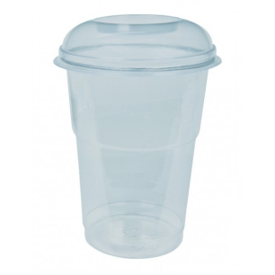
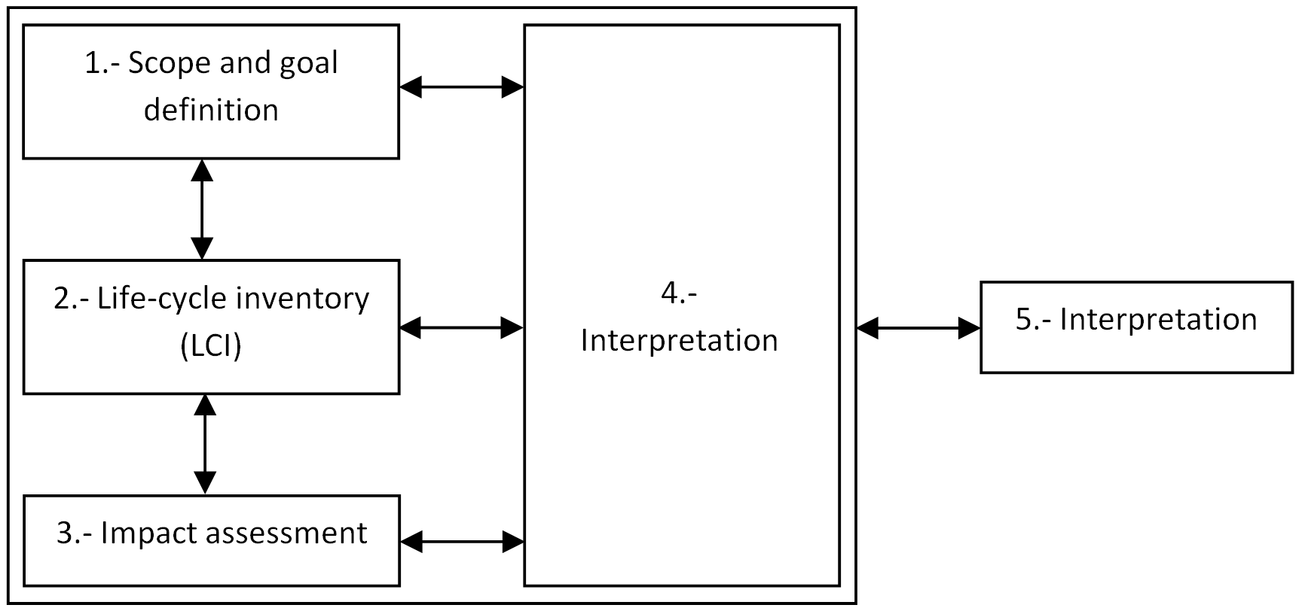
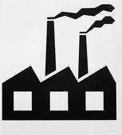
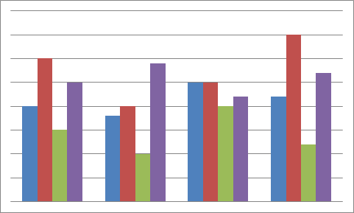
3.- LCA methodology
Several iterations needed!
External review!

Slide 10
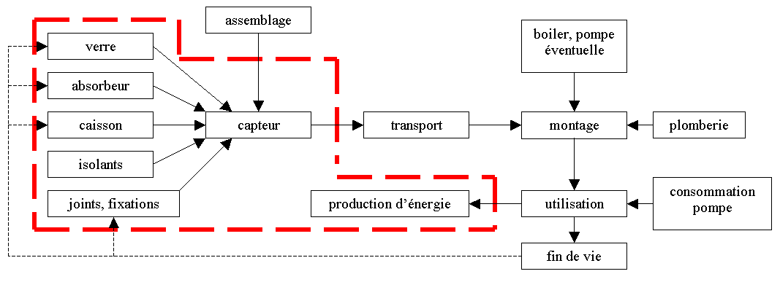
3.1.- Scope and goal (1)
Scope:
    System to be studied
    Border
    Functional unit (FU)
    Assumptions
FU definition
  = unit of service or product for which the impacts are expressed
  Should ideally reprensent the product function (MWh forenergy production)
  If « cradle to gate »: ex. ST: m² is suitable

Slide 11
3.1.- Scope and goal (2)
Typical assumptions:
  Not accounting for a process step
  Limitation to a part of the « lifetime »: acceptable if comparative LCA or if the aim is to study yoiur entreprise
  Time and geographical location (data validity)
  Energy mix
  Allocations (not detailed in this presentation)
Notes:
J’ai ajouté une ligne sur les allocations, si tu n’y vois pas d’inconvénient. (en évitant de devoir expliquer en détails ce que c’est)

Slide 12
3.2.- LCI
List of inputs / outputs during the process, from the extraction of materials to the functional unit:
  Measurements and sampling
  Qualitative work: flow-sheet
  Then, quantitative work
  Extraction from / waste to the environment: importance of the compartment (sea water, ground, urban atmosphere,…)
  Using generic data
  Checking the balance

Slide 13
3.3.- LCIA (1)
Converting inputs and outputs into damage
Different calculation methods, depending on the aime of the study
  CML (Leiden), EcoIndicator99, EPS (monetization), ExternE, Impact 2002+, UseTox, …

Slide 14
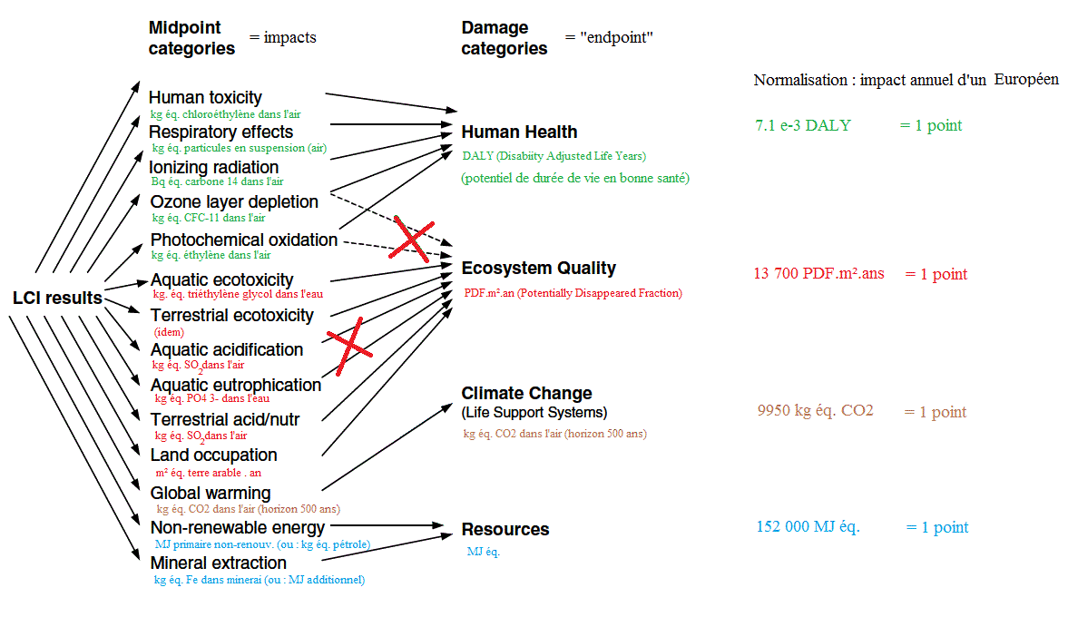
3.3.- LCIA (2)
Principle: example with a midpoint + endpoint method: Impact 2002+ :

Slide 15
3.4.- Interprétation
Main contributions to the impact
Improvements (eco-design)
Comparative LCA
Environmental payback of a renewable energy
  Example : « the energy payback time of a solar collector is 2 years »
Sensitivity analysis

Slide 16
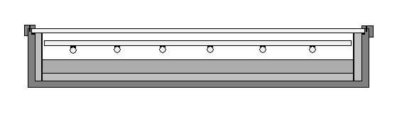
4.- Study case: ST for solar collectors
Main components:
  Absorber (plate + tubes)
  Cover
  Thermal insulation
  Frame
Studied system: absorber ST
  Solarceo® on copper (ArcelorMittal)
  Comparison with the complete collector

Slide 17
4.1.- Scope
Goals:
  Main contributions
  How to reduce the impacts
  Comparison absorber / collector
  Comparison with a « wet » ST
Impact assessment: Impact 2002+ « end-point »
Generic ecoprofiles: EcoInvent
FU: 1m²
Notes:
Attention, il y avait une erreur, j’avais mis « mid-point » et pas « end-point ».

Slide 18
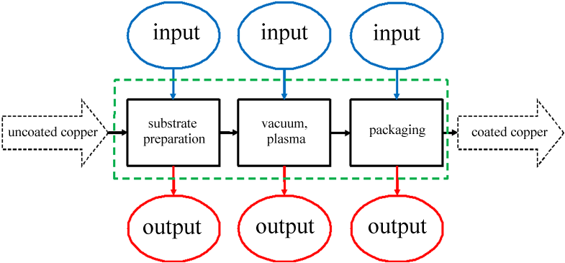
4.2.- LCI (1)
Flexible process adapted for several ST productions (Flémalle)
Simplified view: 3 zones:

Slide 19
4.2.- LCI (2)
4 production steps, during which each zone is active or not:
SOLARCEO production |  | STEPS
 |  | Setting the vacuum | Targets cleaning | Parametrisation | Production
ZONES | Preparation | - | - | Active | Active
 | Vacuum, plasma | Active | Active | Active | Active
 | Packaging | - | - | Active | Active

Slide 20
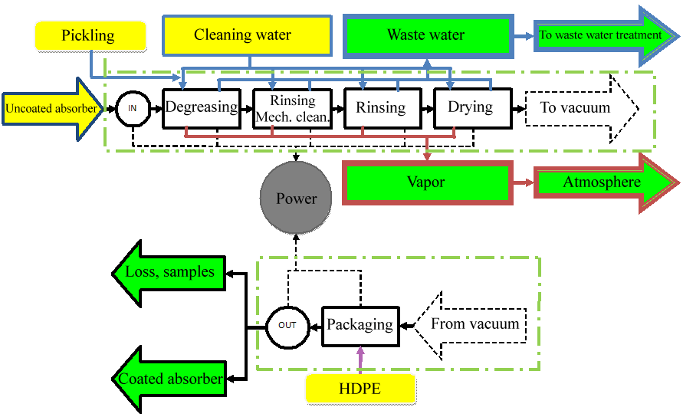
4.2.- LCI (3)

Slide 21
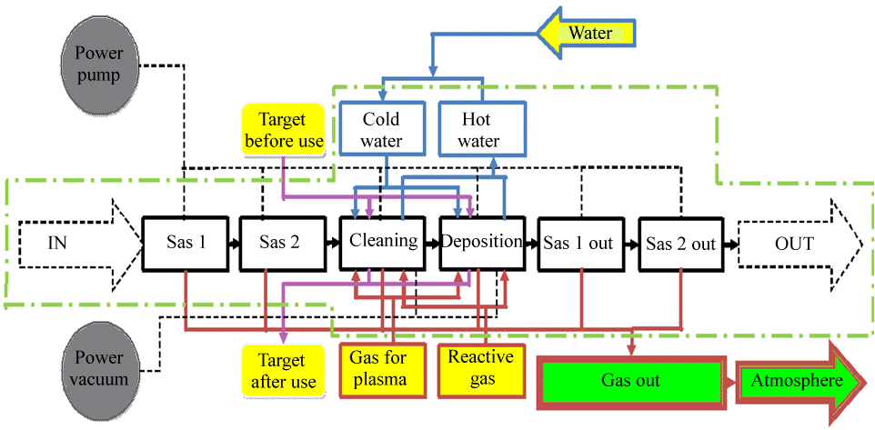
4.2.- LCI (4)

Slide 22
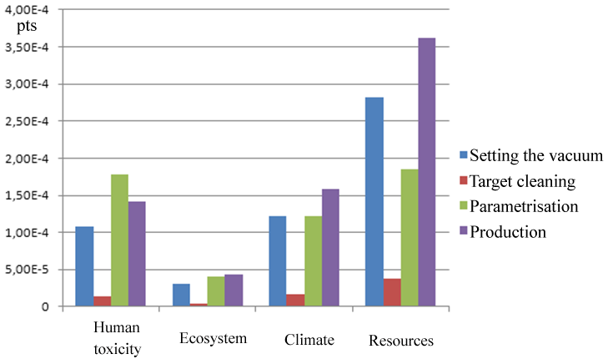
4.3.- LCIA (1)
Per steps:

Slide 23
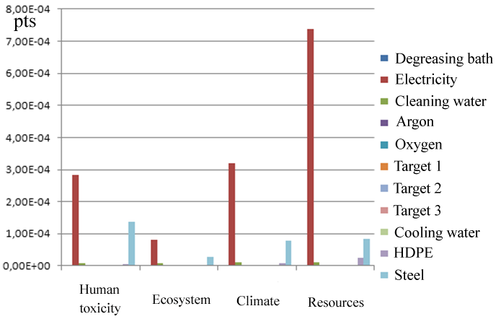
4.3.- LCIA (2)
Per inputs / outputs:

Slide 24
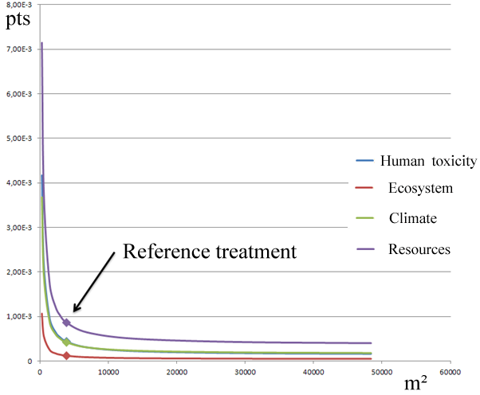
4.3.- LCIA (3)
Influence of the production size:

Slide 25
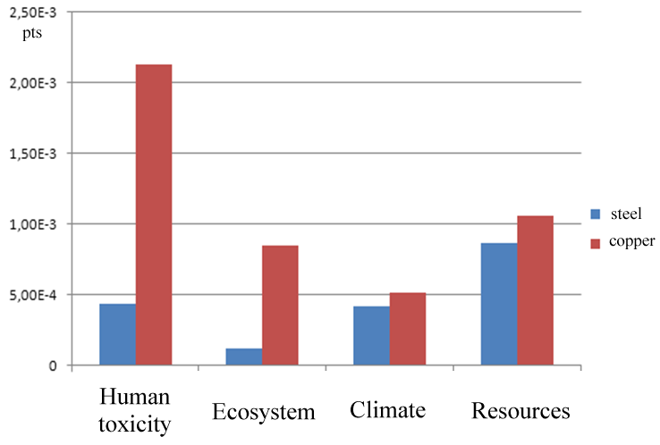
4.3.- LCIA (4)
Influence of the substrate during the parametrisation:

Slide 26
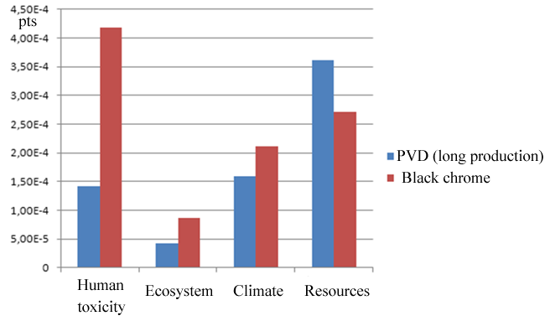
4.3.- LCIA (5)
Comparison with « solar » black chrome (assumption: long production for PVD):

Slide 27
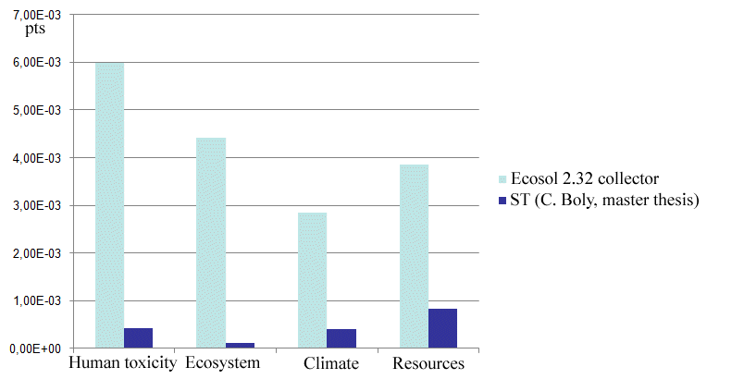
4.3.- LCIA (6)
Reference treatment: comparison with the collector:

Slide 28
4.4.- Interpretation
Importance of the parametrisation step: steel used as a substrate and electricity
ST influences the collector « grand total », but not the main contribution
PVD or black chrome? No clear answer: it depends on the process parameters!

Slide 29
5.- Conclusions
LCA « from cradle to gate » for ST:
  Can become a part for the LCA of a bigger system
  Opportunities:
    Comparing ST
    Improving ST and determining if they are so « dirty » in a product…
    Comparing production steps
    Anticipating future regulations
Requirements: time, money, but also…
  Transparency from all the stakeholders, access to alll the data (input / output)
  Defining a relevant FU
  Databases (EcoInvent)

Slide 30
Further reading
ISO 14044 norm, 2006 (14041 → 14043 = partial versions)
Analyse du Cycle de Vie – Comprendre et réaliser un écobilan, O. Jolliet et al., P.P.U.R., 2nd ed., 2010
A. Léonard et al., « Colloque consacré à l’évaluation environnementale des produits par analyse du cycle de vie », ULg, june 2010
EcoInvent database (www.ecoinvent.org)
GaBi and SimaPro softwares (www.gabi-software.com ; www.pre.nl)
International Journal of Life-Cycle Assessment
ADEME : (http://www2.ademe.fr/servlet/getBin?name=CC14518E88C0E1A15DA50E5C0602DF171115650388946.pdf)
« Bilan Produit » software from the ADEME
Several articles in: Techniques de l’Ingénieur

